Slide 1
Mini Project- 1 Agile cloud automation Group 22
Group Members:
1. Shubham Sonawane – sss81
2. Shivangi Bakori – skb62
3. Dhvanil Patel – dap36
4. JeevanaNtham Balakrishnan – jb1015
5. Arun Selvan kumar kanniyappan – askk2
6. Tarun datta – td188

Slide 2

Healthcare demographics and economics
A Multiple Faceted data analysis on patient profiles , Admissions ,and insurance costs
JB1015

Slide 3

Agenda
Exercise 1 : Choosing a Dataset
Exercise 2: Working with Groovy
Exercise 3: Programming with Mongo DB
Exercise 4: Critical Analysis about standalone and cloud-based solutions
Exercise 5: In-depth Critical Analysis
Exercise 6: conclusion
JB1015​

Slide 4
Exercise 1 About the dataset
JB1015​

Slide 5
About the Dataset selection
Why chosen this Dataset?
Practicing core data operations like selection, projection, filtering, and grouping.
Involves challenges like frequent updates for new patient records and help in creating data visualizations to gain insights into healthcare trends.
Analyze the trends related to demographics, common conditions, and healthcare utilization pattern
Predict patient needs, prevent readmissions.
Include diverse variables such as Age, Gender, Medical Condition, Insurance Provider, and Billing Amount.
JB1015

Slide 6
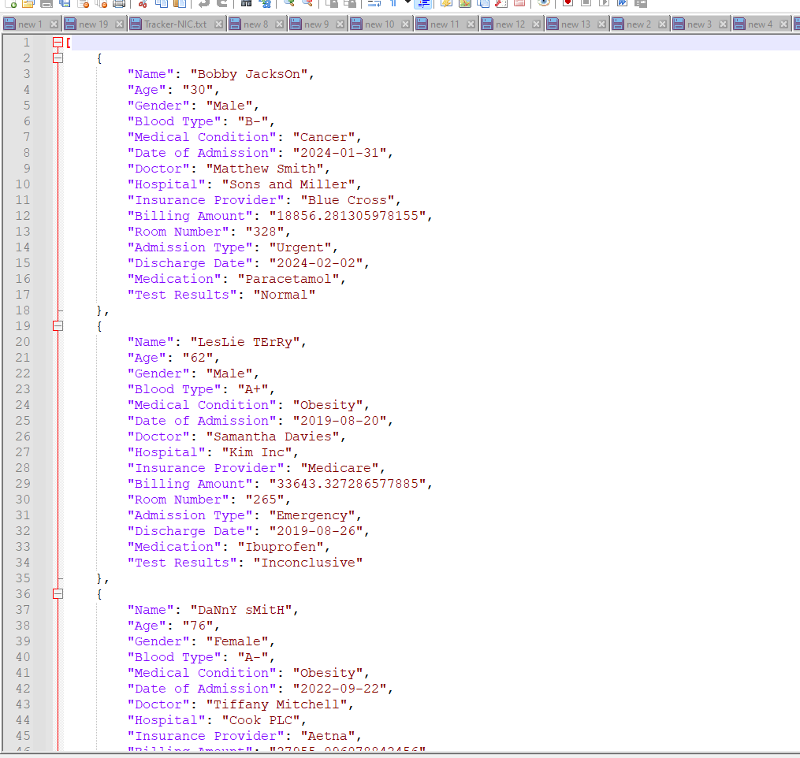
Dataset Functionalities
1
3
4
5
6
7
8
2
Analyze the distribution list
Mapping the three data
Analyze the common medical condition
Aggregating medical condition
MongoDB connections
Collecting the Patient Records
Aggregating the Billing Amount
Finalizing the Pipeline for the Insurance
JB1015

Slide 7
Dataset Query Details
Selection and Projection
Filtering
Grouping and Aggregation
Aggregation with SUM
Sorting Results
Date Filtering
Complex Filtering and Sorting:
SELECT Name, Age, Medical_ConditionFROM HealthcareRecords;
SELECT *FROM HealthcareRecordsWHERE Medical_Condition = 'Cancer’;
SELECT Medical_Condition, COUNT(*) AS Patient_CountFROM HealthcareRecordsGROUP BY Medical_Condition;
SELECT Insurance_Provider, SUM(Billing_Amount) AS Total_BillingFROM HealthcareRecordsGROUP BY Insurance_Provider;
SELECT Name, Billing_AmountFROM HealthcareRecordsORDER BY Billing_Amount DESC;
SELECT *FROM HealthcareRecordsWHERE Date_of_Admission > '2022-01-01’;
SELECT *FROM HealthcareRecordsWHERE Admission_Type = 'Urgent'ORDER BY Date_of_Admission DESC;
JB1015

Slide 8
Exercise 2 query in groovy and Fetching results
skb62

Slide 9
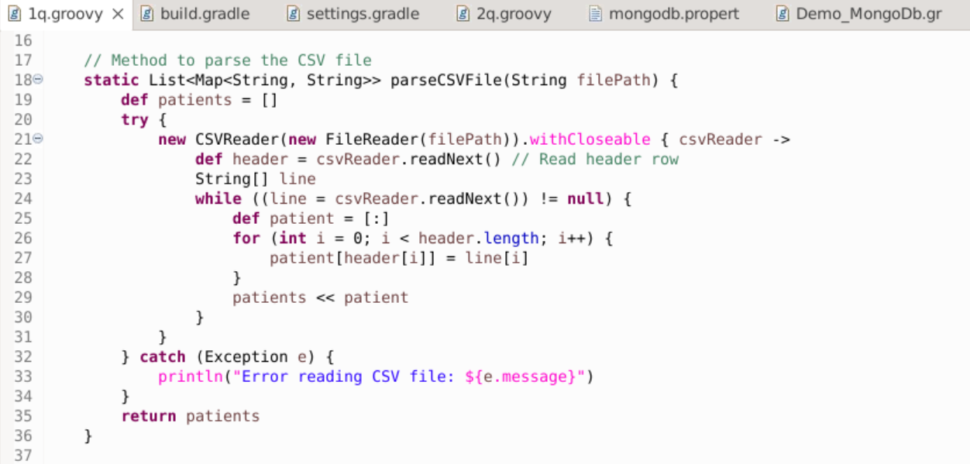
Groovy standalone application Query in groovy-Code cut out 1/3
skb62

Slide 10
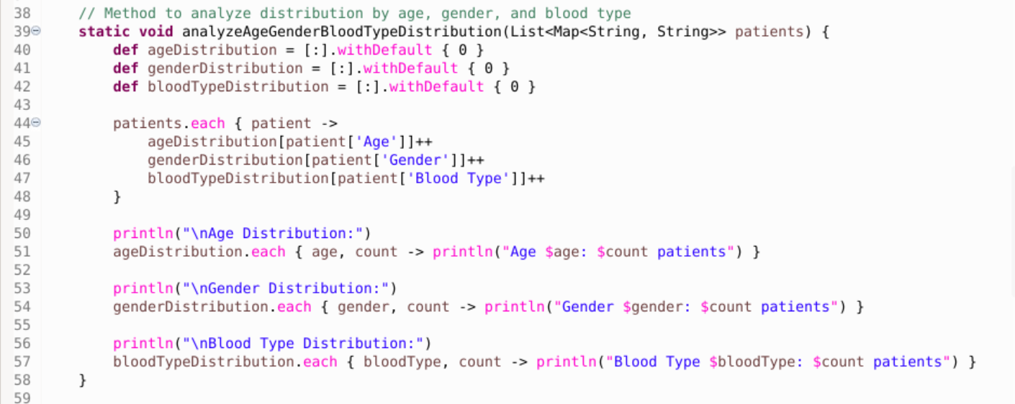
Groovy standalone application Query in groovy-Code cut out 2/3
skb62

Slide 11
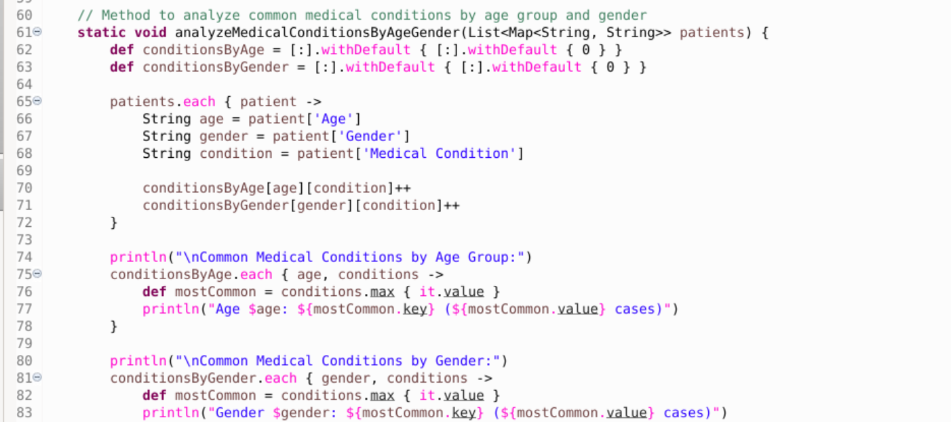
Groovy standalone application Query in groovy-Code cut out 3/3
skb62

Slide 12
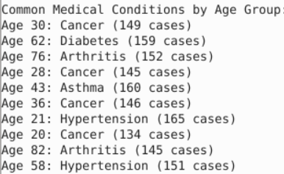
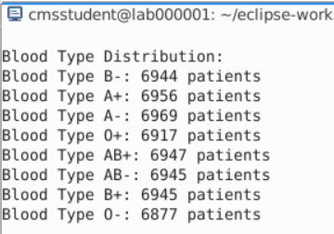

Groovy standalone application Query in groovy-Code result
skb62

Slide 13
Exercise 3 Cloud based application - MongoDB
sss81

Slide 14
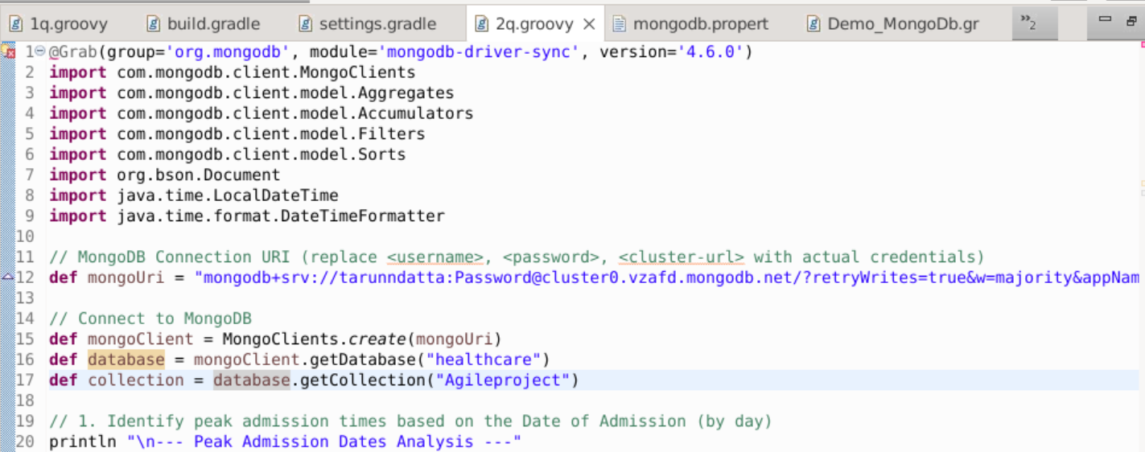
Cloud based application query with MongoDB application- cut out 1/3
sss81

Slide 15
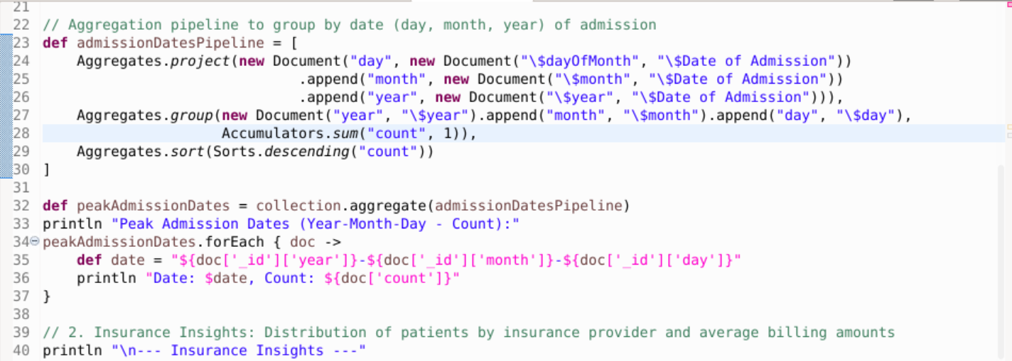
Cloud based application query with MongoDB application- cut out 2/3
sss81​

Slide 16
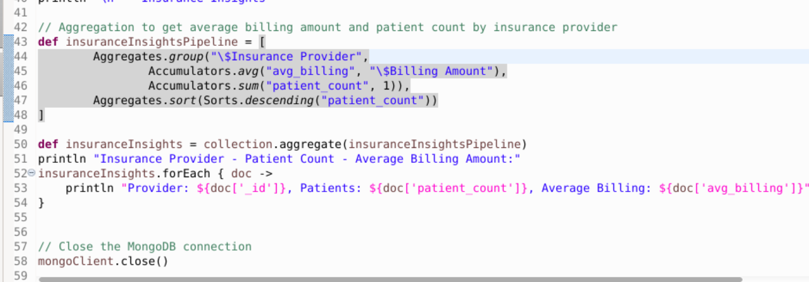
Cloud based application query with MongoDB application- cut out 3/3
sss81​

Slide 17
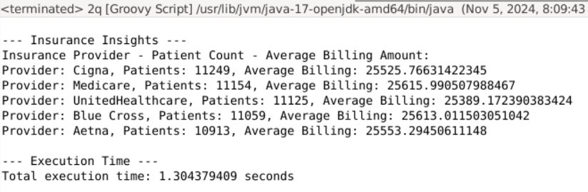
Cloud based application-query in MongoDB – result
sss81​

Slide 18
Exercise 4 Critical comparison of solution regarding scalability

Slide 19
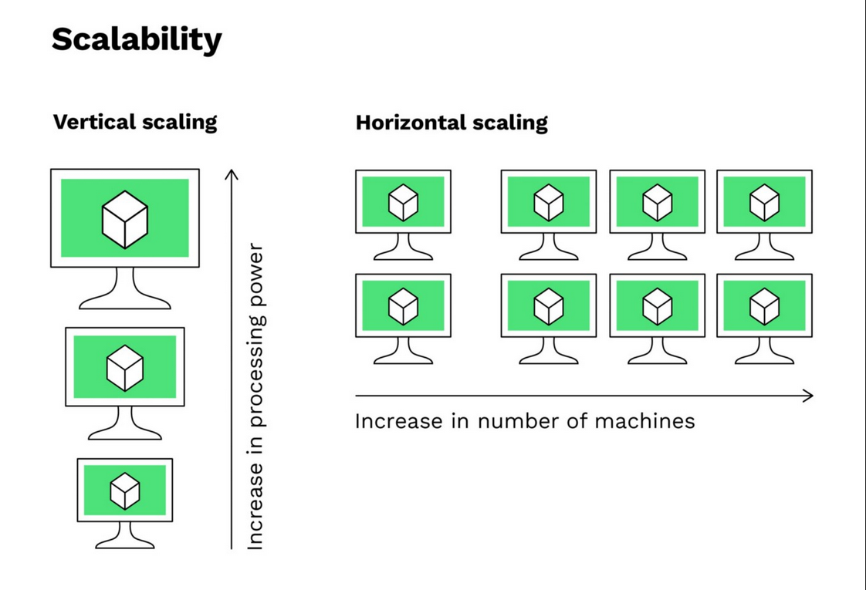
Scalability in nutshell
The ability to expand or contract the capacity of system resources in order to support the changing usage of your application.
Vertical scaling refers to increasing the processing power of a single server or cluster. Both relational and non-relational databases can scale up.
Horizontal scaling, also known as scale-out, refers to bringing on additional nodes to share the load.
askk2

Slide 20


Groovy standalone vs cloud-based solution:
Time to complete the query in groovy standalone:
Time to complete the query in cloud-based solution:
askk2

Slide 21
Groovy standalone vs cloud based solution in mango DB
Standalone
Mango DB Cloud-Based Databases
Standalone: Limited by single-server capacity.
Scaling requires manual hardware upgrades (adding CPU, memory, etc.).
Resources are fixed after scaling up.
A single server failure can make the database inaccessible.
Cloud-Based: Designed for distributed environments.
Offers automatic, on-demand scaling to match current load.
Resources scale up or down as needed, optimizing costs and resource usage.
Minimizes downtime by switching to other servers if one fails, ensuring continuous access.
dap36

Slide 22
summary
Scalability Options:
Cloud-based MongoDB is designed to scale easily.
Automated Sharding and Replication:
With cloud-based MongoDB, sharding and replication happen automatically, making it easy to distribute data and keep backups.
Performance Boosts:
faster and more responsive, especially under high traffic.
Cost Efficiency:
In the cloud, we pay only for what we use, so we can scale up or down as needed.
Easy Monitoring and Maintenance:
Cloud-based MongoDB includes real-time monitoring and automatic scaling.
dap36

Slide 23
Exercise 5 extension of dataset

Slide 24
Data Loading Mechanism
Groovy Solution
Mango DB solution
This method uses a predefined schema to load data straight from the database. This makes it possible to access sizable datasets in real time from a database that is query-optimized.
Groovy Standalone Solution: During runtime, a CSV file is loaded into memory, and data is read from it. This method is limited by memory and file I/O operations, but it performs well for smaller datasets.
Cache Mechanism​
Data that is frequently accessed can be swiftly retrieved thanks to caching mechanisms that MongoDB natively supports. MongoDB can also speed up subsequent requests by caching query results in memory.
Following the initial retrieval, the Groovy code creates a basic in-memory cache to hold query results. Instead of reloading the CSV file, the data is retrieved from this cache if the same query is asked again.
td188

Slide 25
Scalability Mechanism
Query Performance and Indexing
Mango DB solution
MongoDB offers sophisticated querying features along with indexing support. The creation of indexes on fields such as age and medical condition speeds up queries by enabling users to find pertinent documents without having to search through the entire collection
The Groovy solution does not support indexing in the absence of a database engine. Rather, it runs a linear search across the in-memory dataset, which gets less effective as the dataset gets bigger
Maintenance and Evolution
With features like automatic backups, integrated security, and support for schema evolution, MongoDB is a popularly used and maintained database. It is therefore simpler to maintain, expand, and update over time.
Schema flexibility is not present in CSV files. Updates to the Groovy script would be necessary for any modifications to the dataset format, such as adding or deleting columns. Additionally, this solution lacks backup plans and security, which makes long-term maintenance more difficult.
td188

Slide 26
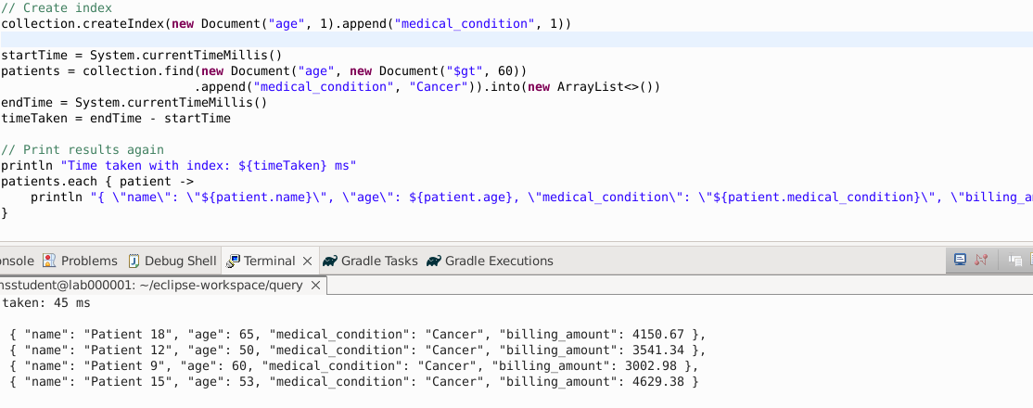
Extension of the dataset
td188

Slide 27
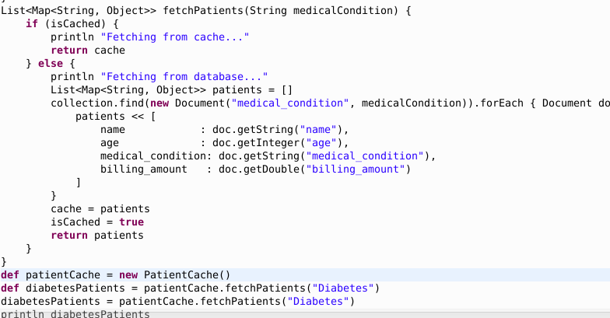
Mapping the patient dataset
td188

Slide 28
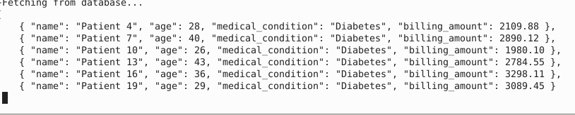
Output for the dataset
td188

Slide 29
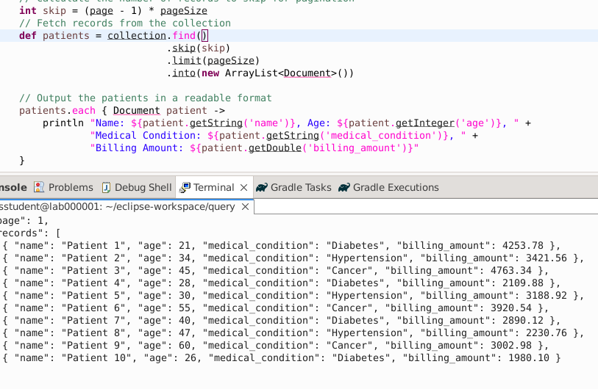
Patient Record of the dataset
td188

Slide 30
references
Dataset : https://www.kaggle.com/datasets/prasad22/healthcare-dataset?resource=download
Mango DB :
Gradle : https://docs.gradle.org/current/userguide/getting_started_eng.html
Groovy : https://docs.groovy-lang.org/next/html/documentation/
https://www.mongodb.com/docs/ ​
​

Slide 31

Thank you

